Slide 1
Database relationships
Abdifatah Yassen Yosuof

Slide 2
What is a relation in a database?
The term relation is sometimes used to refer to a table in a relational database. However, it is more often used to describe the relationships that exist between the tables in a relational database.
A relationship between two database tables presupposes that one of them has a foreign key that references the primary key of another table.

Slide 3
Database entity—strictly speaking — is a person, place, thing, object, or any item about which data is stored in the database. However, the term is usually used to refer to the database table as tables are, in fact, the physical implementation of entities.

Slide 4
An entity-relationship diagram, also known as ERD, ER diagram, or ER model, comprises a graphical representation of how entities relate to each other within a database.
ER models are widely used in database design as they are fairly abstract and are easy to view and analyze.

Slide 5

ER diagram

Slide 6
Types of relationships in a database
There are 3 main types of relationship in a database:
one-to-one
one-to-many
many-to-many.

Slide 7
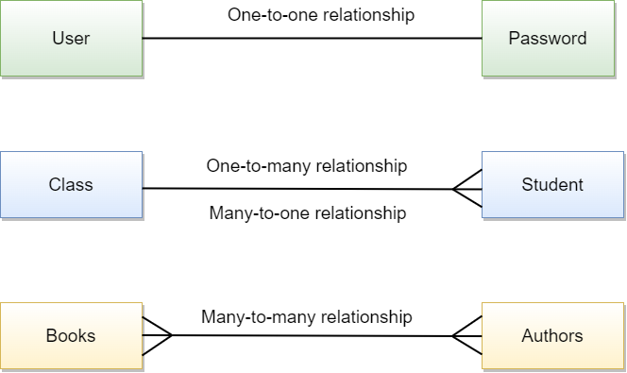

Slide 8
1. One-to-one: A user has one (and only one) password.
2. One-to-many: A class can have many students, and a student can attend one (or more) classes.
3. Many-to-many: An author can write multiple books, and a book can have multiple authors.

Slide 9
Primary key
The primary key is a column (or a set of columns) that uniquely identifies each row in a table. It ensures that each record in the table is unique and can be easily referenced.

Slide 10
Foreign key
The foreign key is a column (or a set of columns) in one table that references the primary key of another table. It establishes a relationship between the two tables, allowing you to link and associate data between them.

Slide 11
By using primary keys and foreign keys, you can create a well-structured and normalized database design that maintains data integrity and enables efficient data retrieval and manipulation.

Slide 12
one user can have one password
- Primary Key: In the "users" table, the "user_id" column is the primary key. It uniquely identifies each user.
- Foreign Key: In the "passwords" table, the "user_id" column is the foreign key. It references the primary key "user_id" in the "users" table. This establishes the one-to-one relationship between a user and their password.

Slide 13
one class can attend many students - many students can attend one class
- Primary Key: In the "classes" table, the "class_id" column is the primary key. It uniquely identifies each class.
- Foreign Key: In the "students" table, the "class_id" column is the foreign key. It references the primary key "class_id" in the "classes" table. This establishes the one-to-many relationship between a class and its students.

Slide 14
many authors can write many books - many books can have many authors
- Primary Key: In the "authors" table, the "author_id" column is the primary key. It uniquely identifies each author.
- Primary Key: In the "books" table, the "book_id" column is the primary key. It uniquely identifies each book.

